Slide 1

CAV RP Statement of Work (SOW)
Presented to:
CAV RP Symposium
Presented by:
Sara Duggan
CAV RP Lead, NAVSUP WSS, N85B4

Slide 2
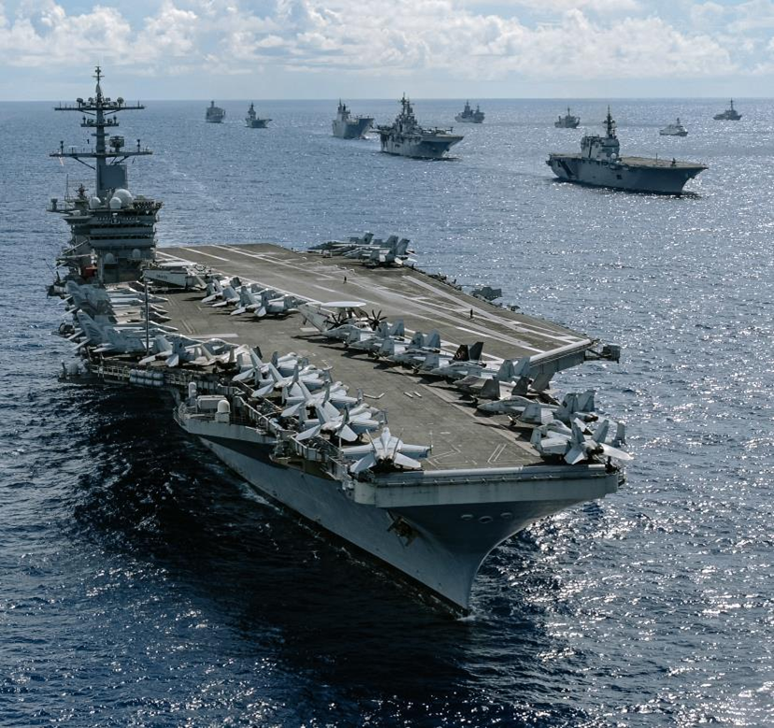
CAV SOW Overview
Objective: Understanding the FY26 CAV SOW's Purpose
Updates: Highlight Key Changes from FY25 to FY26
Framework: Breakdown of the SOW at a high-level overview
      Upcoming presentations to cover topics in detail
      QR Code – questions
CAV RP SOW Link:
https://www.navsup.navy.mil/NAVSUP-Enterprise/NAVSUP-Weapon-Systems-Support/Provisions-Instructions-and-Contract/
Insert photo or graphic here

Slide 3


I & II. Purpose of CAV SOW
Guide
  A step-by-step guide on requirements from time of receipt to time of shipment
Fleet Readiness
  Your actions directly impact readiness on the front lines.
  Timely and accurate receipt and shipment reporting
  Visibility of asset status as they flow through the repair cycle
    Real time status of assets
    Provides supply planners critical information for management decisions
    Tracking of in-transit shipments to and from the Contractor
Accountability & Auditability
  Creates a single, accurate record for all property.
  Contract compliance, audit readiness
  Paper trail – key supporting documentation
Insert photo or graphic here

Slide 4

CAV Statement of Work Key Changes
(Version 8.6 – Effective FY26)
Contractor Responsibility:
***Contractors are required to adhere to the most current CAV SOW version
available on the NAVSUP website***
Section D: NWCF Inventory Accountability:
Wall-to-Wall Inventory Flexibility (Annual)
  PBL sites who are unable to complete a single NIIN and condition code count in one business day during wall-to-wall inventory submissions may be eligible to conduct the count by serialized count sheets pending NAVSUP approval.
New Quarterly Confirmations
  NAVSUP or Individual Public Auditor (IPA) will now request quarterly confirmations of NWCF material. This requires submitting an asset listing in Microsoft Excel format sent by HQ -Warning order (WARNORD)
    Submission - new mailbox NAVSUP-Confirmations@us.navy.mil
***W2W and confirmations are two separate requirements***

Slide 5


III. General & Security (Pages 1-2): The Foundation
Security
System Reporting Issues
Ensures only authorized personnel can access the CAV system.
  PKI Certificate
  DD Form 2875/SAAR
  Navy User Agreement
  Cyber Awareness Certification (Annual)
  CAV Analyst will be your sponsor
Each individual completes each form separately but multiple plants can be listed per SAAR
Scheduled CAV RP training with the CAV Analyst
Note the nature of the problem and the screen the failure occurred
  Notify your CAV analyst
Catastrophic Events
  Flood, fire, hurricane, etc.
  Contact contracting officer & CAV Analyst
    24-Hour Contact Window
Insert photo or graphic here

Slide 6

IV A&B. Training & Reporting (Pages 3-6): Reporting Responsibility
Training Requirements
Contractors are to provide trained & qualified individuals to perform CAV RP transactions
Contractors will send at least one representative to any scheduled CAV training to learn the official procedures firsthand.
Transaction Reporting
Report asset status within 7 business days
Upon request, contractor must provide KSDs to NAVSUP within 10 business days of notification
  If cannot deliver within 10 BD → Written rationale as to why KSDs cannot be provided & estimated completion date to fulfill request
Reporting receipt of materiel through CAV RP is required when any contract states the CAV SOW is applicable
Insert photo or graphic here

Slide 7
IV B. Training & Reporting (Pages 3-6): Transaction Reporting
Materiel reported
Completion reporting
Shipment reporting
Materiel received on Document Number
Incoming Government Furnished Property listed as repair on contract
NAVSUP WSS Managed items
NWCF materiel
Warranty or Product Quality Deficiency Report (PQDR)
Any unique receipts requested by NAVSUP
Materiel not on contract
Materiel for testing
RFI Materiel: Provide DCMA Quality Assurance Rep (QAR) RP inventory labels and WAWF documentation prior to DCMA Rep inspection
DCMA Rep performs inspection and acceptance and provides the DD250 signature in WAWF
Report shipment transactions 24 hours prior to physical shipment – allows for potential requisitions to be filled
Report POS if shipment is outside of ATAC
Local deliveries without freight carriers: POS & POD
Insert photo or graphic here
***7 Business Days to report in CAV RP; File and retain for 10 years***

Slide 8
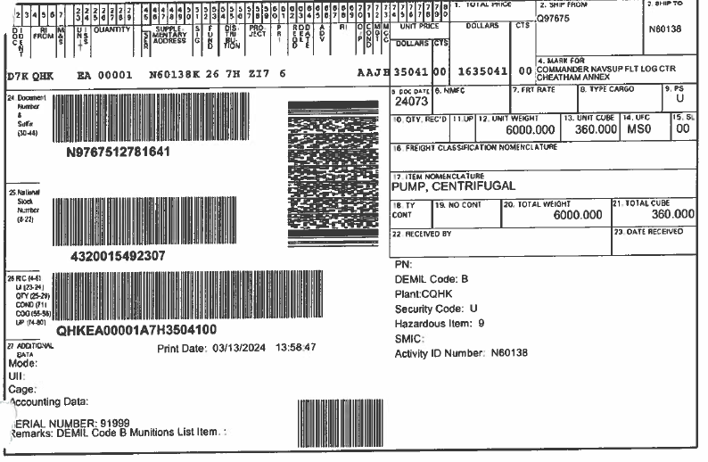
Filling out Inbound DD Form 1348
Verify the ship to DoDAAC is your DoDAAC
Verify:
NIIN
Quantity
Document Number
Condition Code
Serial Number (if applicable)
Date of action; signature, and legibly printed or stamped name of custodian. (See Section B.7 of CAVSOW)
***Post transaction within 7 business days of contractor signature***

Slide 9

IV C. NWCF Inventory Accountability Responsibilities, Wall-to Wall (Pages 6-7)
The SOW states a non-negotiable requirement for all contractors to use the Product Data Reporting and Evaluation Program (PDREP) for managing all Supply Discrepancy Reports (SDRs).
***Page 6, C-2, “Reporting in Product Data Reporting and Evaluation Program (PDREP) as both an SDR Originator and Action Point responsible for resolving the SDR is required.” ***
Your Responsibility:
Go to: https://www.pdrep.csd.disa.mil
Register your account and designate your internal Action Points.
Quantifiable Aspects:
An SDR must be submitted within five (5) business days after a discrepant shipment is received.
Contractors must reply to Supply Discrepancy Reports (SDRs) within thirty (30) business days.
Include SDRs with outbound shipment

Slide 10


IV D. NWCF Inventory Accountability Responsibilities, Wall-to Wall (Pages 7-8)
Wall-to-Wall
(W2W)
Requirement
Discrepancies
PBLgraphic here
Reporting period (October 1 – July 31st)
Perform an annual 100% physical inventory to be completed and submitted by July 31st.
A single "wall-to-wall" event or a cycle count program that achieves 100% coverage.
Unresolved discrepancies must be formally reported on the Discrepancy Tracker template.
Resolve by August 31st (30 days to perform corrective actions)
Additional research and corrective action plans, if required, should be forwarded to the W2W mailbox
PBL with multiple sub-vendors that are unable to complete a single NIIN & condition code in one day may be eligible to conduct the count by serial number pending approval
Email W2W inbox for request
Insert photo or graphic here
usn.Mechanicsburg.navsupwssmech.mbx.cav-w2w-inventory@us.navy.mil

Slide 11


IV D. NWCF Inventory Accountability Responsibilities, Confirmations (Page 9)
Confirmations
What
Separate from the annual W2W requirement
Confirmation of NWCF materiel held by your organization as of date requested
Quarterly assessment in support of the DoN WCF financial statements
Ernest Young (E&Y) will be evaluating/auditing this quarters confirmations, which will be reviewed by the IPA for an opinion
Confirmation submission to NAVSUP-Confirmations@us.navy.mil
How
Report from your local system that is a complete asset listing
Report should be generated from local system NOT CAV RP
Attributes:
  NIIN
  Nomenclature
  Quantity
  Serial Number
  Condition Code
Insert photo or graphic here

Slide 12


IV D. – NWCF Inventory Accountability Responsibilities, Audits (Page 9)
Inventory Audits
The Contractor is subject to inventory audits by the Government or a third party
At Government’s discretion
  Conduct existence and completeness (E&C) visits
    Book to Floor
    Floor to Book
  Conduct virtual inventory audit:
    digital media images of ID plates showing part numbers and serial numbers
Contractors are required to provide documentation associated with CAV RP reportable materiel that is on-site or has been on-site during performance of the contract
  Documentation maintained by the contractor through the course of the contract & in support of the CAV RP SOW
    DD1348s, DD250s, DD1149s
CAV RP reportable inventory must be clearly marked or physically separated from other assets at facilities
Insert photo or graphic here

Slide 13

IV E. Reconciliation Requirements, LDD – Loss, Damaged, Destroyed
(Page 9-10)
Inventory Losses
When contractors are responsible for acknowledging inventory loss:
  Within 5 days of receipt of audit or physical inventory after action-report findings
  Within 5 days after the CAV Analyst notifies the contractor of lost Stock-In-Transit due to non-receipt or outbound shipments with invalid or no POS
Submitting LDD:
  The contractor is responsible for submitting a written request for relief of liability to their DCMA rep.
  Report the loss through the Government Furnished Property (GFP) module of the Procurement Integrated Enterprise Environment (PIEE) – DFARS 252.245-7005
  Must provide a copy of the request to your CAV Analyst and PCO
  CAV Analyst will update CAV RP inventory balances after receiving a copy of the written LDD resolution

Slide 14
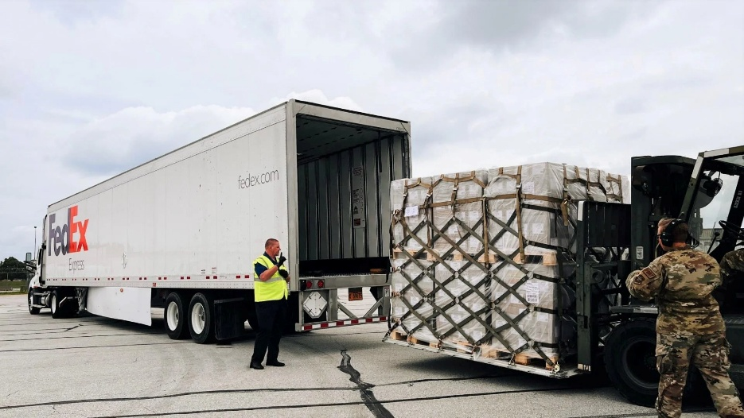
IV F. In-Transit Accountability (NITA) (Page 10-11)
Overview & Quantifiable Aspects
Contractors must access NITA at a minimum of once every seven (7) calendar days.
Responses for classified/sensitive materiel are due within seven (7) calendar days.
  Proof of shipments (POS)
  Proof of receipt (POR)
  On-hand acknowledgement (OHA)
Responses for all other non-classified materiel are due within 30 calendar days.
If a POS, POR, or OHA remains unresolved for 60 calendar days, the contractor must process a transaction or submit an LDD.
Any receipt transaction errors must be corrected within 30 days of the original transaction.
Responses to open Stock In-Transit inquiries by NAVSUP are required no later than the next working business day.

Slide 15

IV G. DD Form 1348-1A (Page 11)
Overview
Documentation is Key:
  DD Form 1348-1A is the only authorized shipment form for CAV RP Reporting.
  DD-250 & DD-1149 are not permitted with shipments from CAV RP reporting contracts
Single Unit Shipment:
  Place one DD1348 on this inside of the container and one on the outside
Bulk Shipment Packaging:
  Place DD1348 on the outside and inside of each individual unit container and a third DD1348 on the outside of the multi pack container
  Up to 10 units

Slide 16

IV H. Direct Ship (Page 11-12)
Timely and Efficient:
Direct ship is designed to ensure critical repaired “A” condition assets are directly delivered to the Navy end-user
Contractor facility → supply depot → fleet activity
Does not apply to Performance-Based Logistics (PBL) or Mini-Stock Point contract.
24-Hour Rule:
After reporting the transaction, you are required to wait up to 24 hours before physically shipping the item.
DCMA inspection and acceptance are still required
Shipment guidelines are provided in the Requisition Report if there is an existing requirement
If no existing requirement – ship materiel per the DoDAAC specified in the repair contract

Slide 17
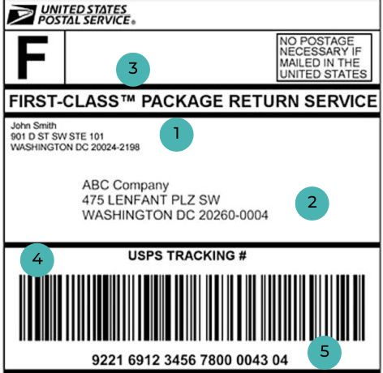
IV I. Materiel Returns and Navy Transportation
(Pages 12-15)
Follow Disposition Instructions from NAVSUP
Material not on contract or authorized for repair
Materiel beyond economical repair
Requisitions
Utilize Government Transportation – ATAC
Responsibility – delivery and pick up of Navy assets to and from Contractor
Sends contractor shipping labels and assigns subcontracted transporter
Documentation is Critical
DD1348-1A, SDR – Qty or NIIN discrepancy
Proper Packaging and Preservation
When possible, consolidate units of same material going to same location
Emergency Shipments:
Shipments that must leave repair facility prior to next ATAC pickup
    Contact DCMA rep, shipment transaction in CAV RP, contact ATAC:
      7:00AM-4:30PM PST – Advise an urgent pick up
      ATACCustomerService@us.navy.mil | (619) 545-6129; (619) 545-7059

Slide 18
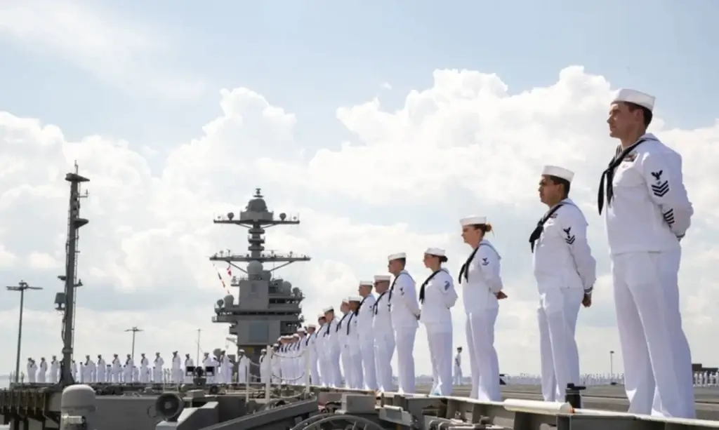
IV J. – Requisition Processing/ Shop-Repairable Assembly (SRA) Requisitioning (When Applicable) (Pages 16-17)
Purpose
Describe the process for how to respond to and fulfill direct orders (requisitions) from the government for the inventory being held.
Contractors are required to use the Government Furnished Materiel (GFM) creation tile when requesting a Shop-Repairable Assembly (SRA) to complete a next higher assembly
Active Monitoring of Requisitions
  PBL
  Mini-Stock Point (MSP)
  Direct Ship
Acknowledge and Respond to Requisitions
  Order Fulfillment
  Shipment Prep

Slide 19

IV V. Dawn Of Time (“DOT”) Inventory Applicable To New CAV RP Reporters (Page 17-18)
Purpose
One-time entry criteria for contractors being onboarded into the CAV RP system for the first time.
Requirements
Roll Forward of Inventory
  Report inventory count to CAV Analyst 1 week prior to scheduled implementation on to CAV RP
CAV RP User identification
  At minimum, a primary and alternate CAV RP point of contact
  User requirements – PKI, SAAR, Navy User agreement, Cyber Security training
Inventory management
  Contractor will assist CAV RP Analyst with loading initial inventory from local accountable record of inventory into CAV RP

Slide 20

Key Takeaways
W2W and confirmations are two separate requirements
7 Business Days to report in CAV RP; File and retain for 10 years
Verify NIIN, Qty, document number, condition code, and serial number (if applicable) on inbound DD1348-1As
Contractor is subject to inventory audits by the Government or a third party
DD Form 1348-1A is the only authorized shipment form for CAV RP Reporting
After reporting a shipment transaction, you are required to wait up to 24 hours before physically shipping the item

Slide 21

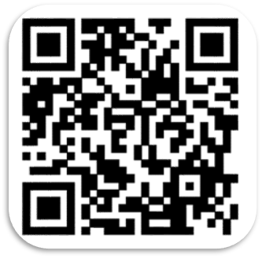
Questions?

